Slide 1
Interdisciplinary Science

Slide 2

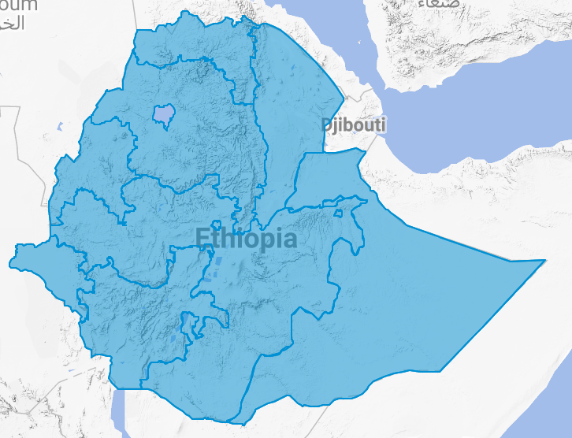
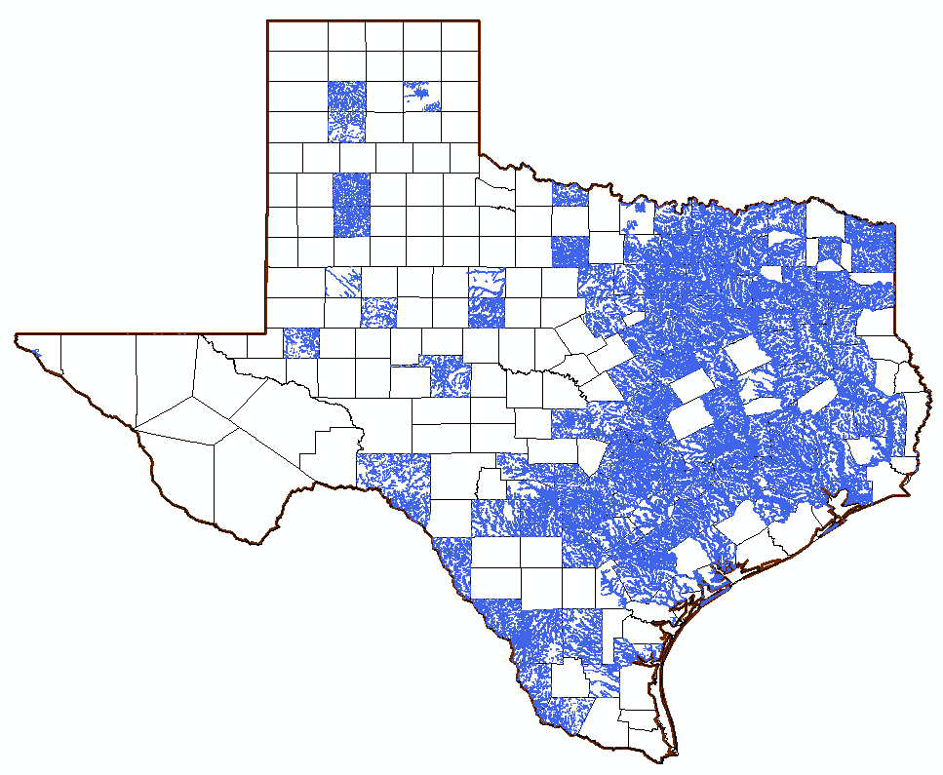
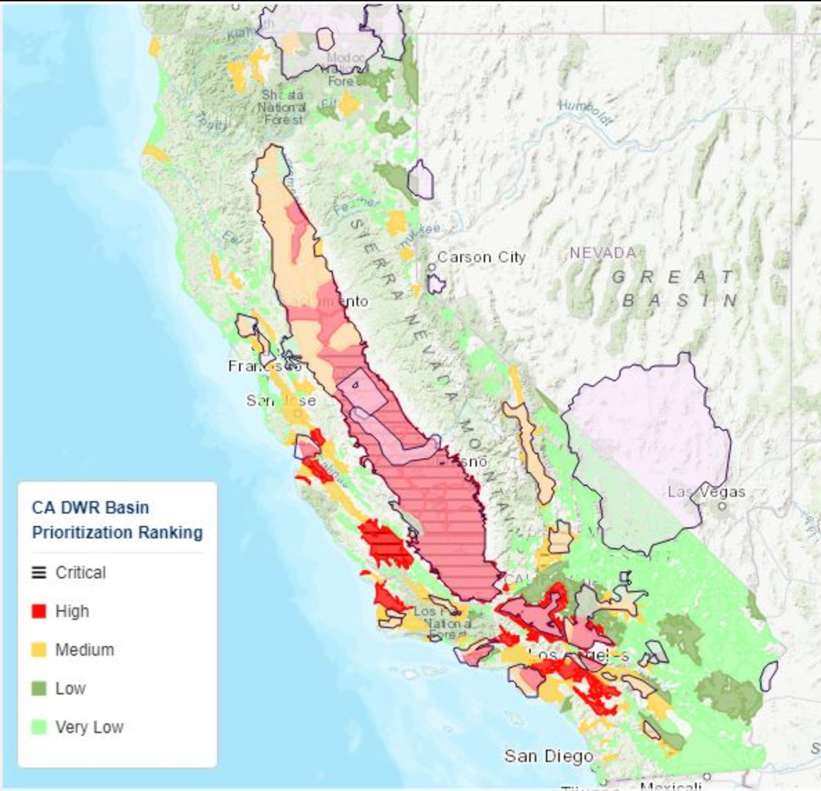
MINT: Model INTegration
Collaboration with Daniel Garijo, Deborah Khider, Craig Knoblock, Ewa Deelman, Rafael Ferreira (USC/ISI), Vipin Kumar (UM), Scott Peckham (CU), Chris Duffy & Armen Kemanian (PSU), Kelly Cobourn (VT), Suzanne Pierce (UT)
Food-Energy-Water
Nexus
https://commons.wikimedia.org/wiki/File:FEMA_-_43937_-_Flood_Damaged_Tennessee.jpg
https://www.pexels.com/photo/bird-birds-blue-sky-drought-1178291/
https://www.publicdomainpictures.net/en/view-image.php?image=256538&picture=agriculture-farming

Slide 3
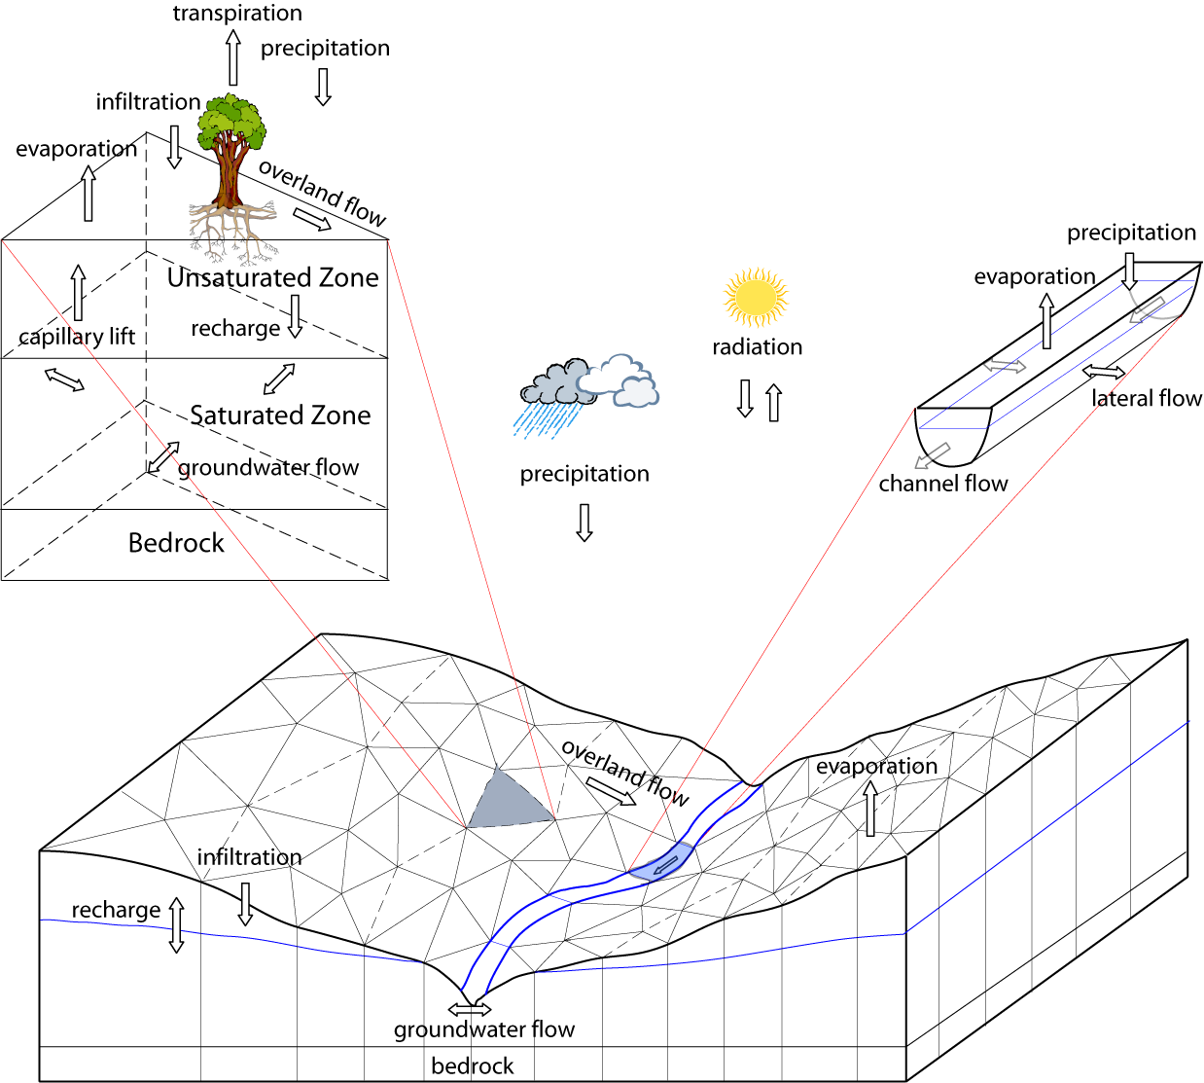
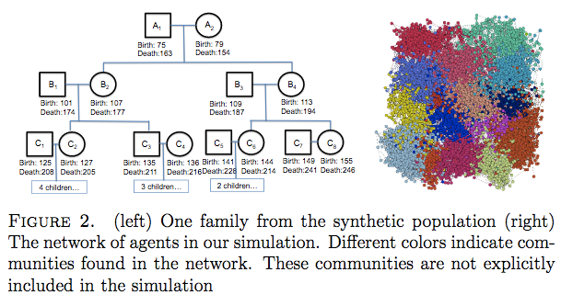
Integrated Modeling
Economic Models
Mediation at many levels
Agriculture Models
Social
Models
Takes months/years
Currently a craft
Increased demand
Modeling scope
Natural Models
Infrastructure
Models
Model
set up
Variable mapping
Data
ingestion
Spatial
gridding

Slide 4
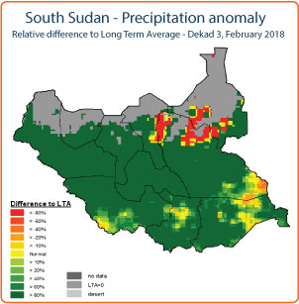
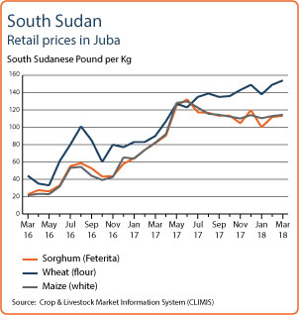
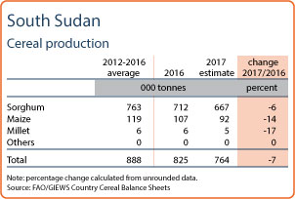
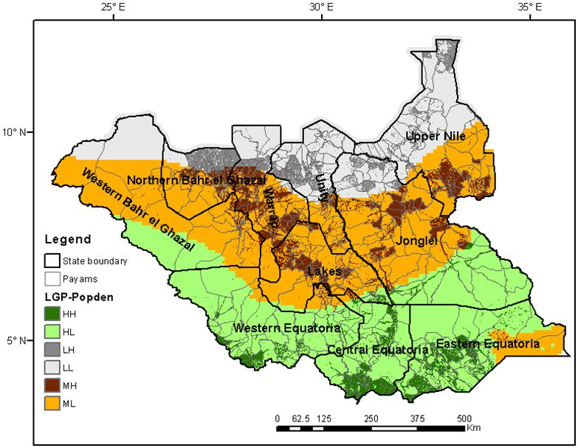
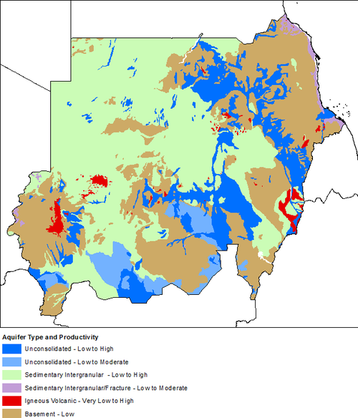
Spatial Datasets of Varying Quality
Temperature
Precipitation
Crop prices
Production
http://www.scirp.org/journal/PaperInformation.aspx?paperID=76775
http://www.fao.org/giews/countrybrief/country.jsp?code=SSD
Land use
Agricultural potential
Aquifer productivity and recharge
Diao, X. et al. DOI: 10.5772/47938
Diao et al DOI:10.5772/47938
http://earthwise.bgs.ac.uk/index.php/Hydrogeology_of_Sudan

Slide 5
Mapping Models to Interventions and Decisions
Drivers and
adjustable
parameters
Response
variables
Weather
Crop types
https://commons.wikimedia.org/wiki/File:Phosphorus_Cycle_copy.jpg
Crop yield
Fertilizer
Model parameters
Planting dates
Nitrogen stress
Weed factor
Soils
Land use
Solar radiation

Slide 6
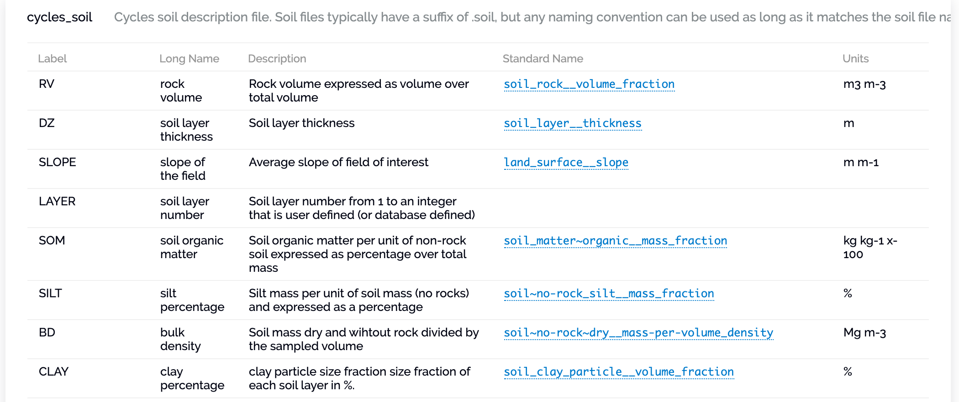
Ontologies for Unambiguous Physical Variables
Work by Scott Peckham and Maria Stoica (CU)
Ontology of standard scientific names [Peckham iEMSs 2014; Peckham & Stoica 2019]
Eg SSN: watershed_outlet_water__volume_outflow_rate is more precise than “streamflow” or “discharge”

Slide 7
Rich Representations of Data
Steps of building data representation
Files
Variables
Mappings
Semantic representation

Slide 8
Automated Data Transformations
Create a saturation file for each mesh cell
Work by Craig Knoblock, Yao-Yi Chiang Jay Pujara (USC)
pg.gw file
Cycles.REINIT file
Time | Mesh 1 | Mesh 2 | ... | Mesh n
1440 | 3.595513 | 6.534754 | ... | 3.771523
2880 | 3.595509 | 6.534728 | ... | 3.771488
4320 | 3.595505 | 6.534702 | ... | 3.771453
... | ... | ... | ... | ...
ROT | DOY | VARIABLE | VALUE
1 | 1 | INFILTRATION | 0.0
1 | 1 | SATURATION_L1 | 0.0
1 | 1 | SATURATION_L2 | 0.012
... | ... | ... | ...
Create a data graph for each cell
Write the data graph as a row
pihm:SoilDepth_1
Saturation transformation
cycle:Variable_1
depth
doy
recordedAt
meshId
var_name
1
3.595513
value
year
1
SATURATION_L1
1440
1
0.0
Hydrology model gives depth until ground water
Agriculture model requires saturation

Slide 9
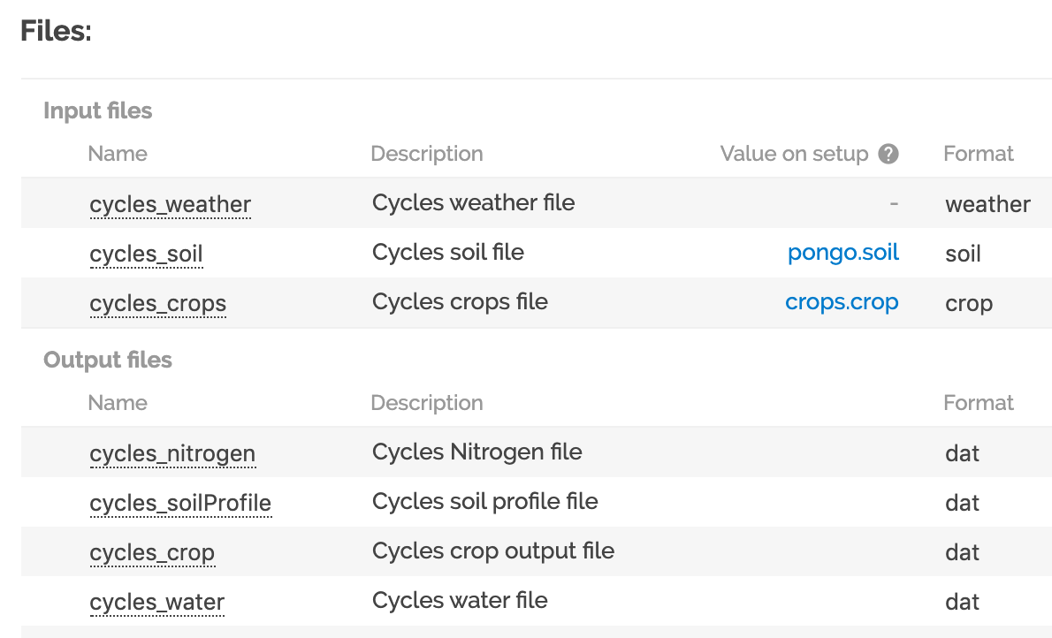
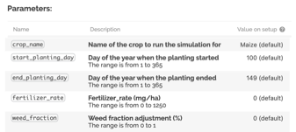
Rich Representations of Models
Work with Daniel Garijo, Deborah Khider, Varun Ratnakar, Maximiliano Osorio (USC)
Data formats
Physical variables
Constraints
Adjustable parameters

Slide 10
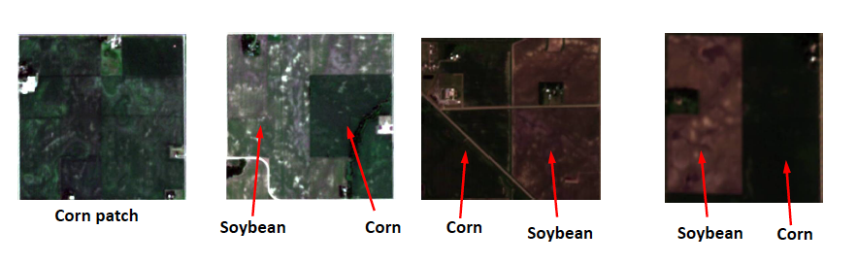
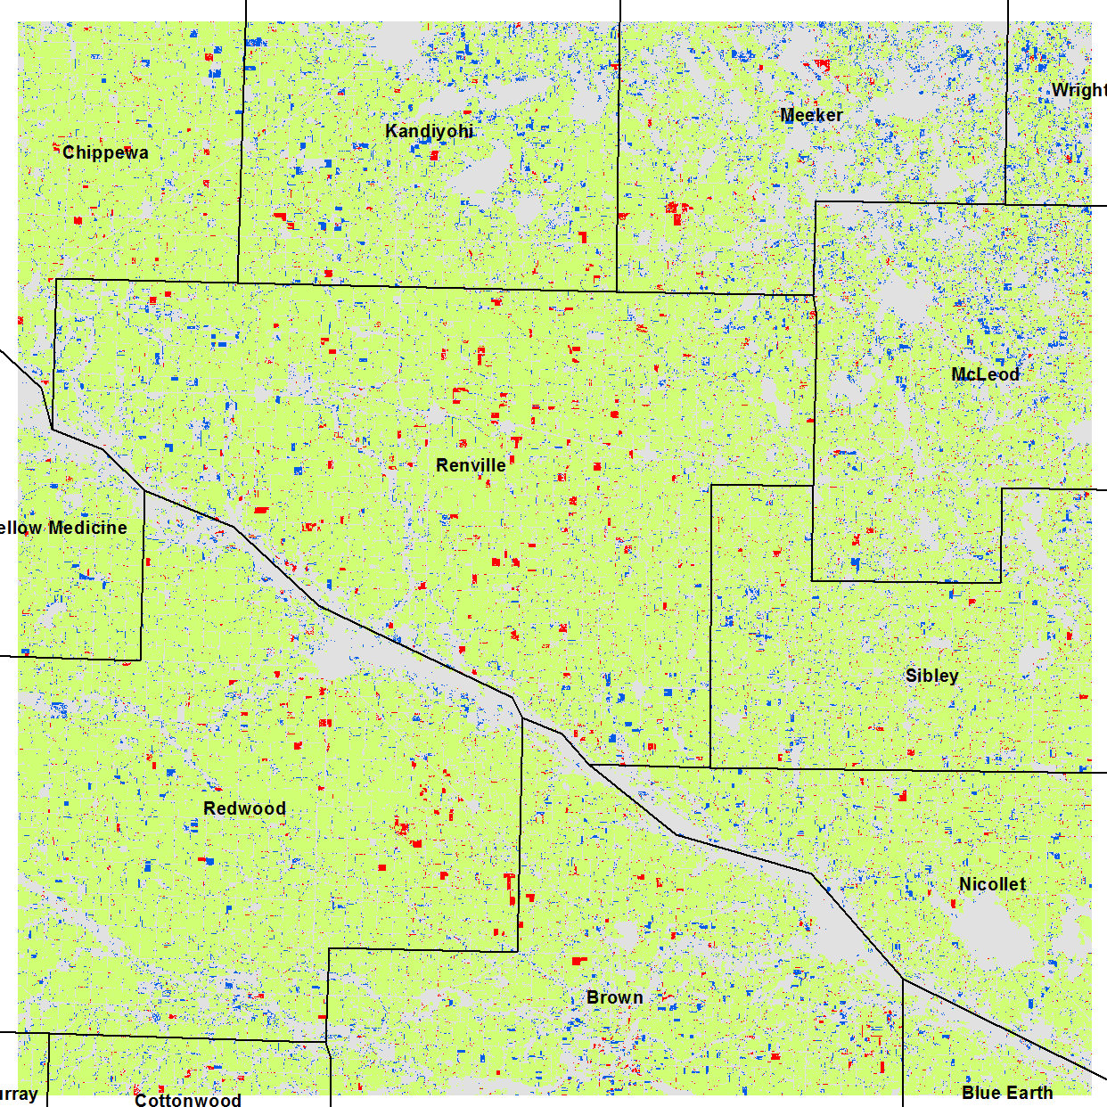
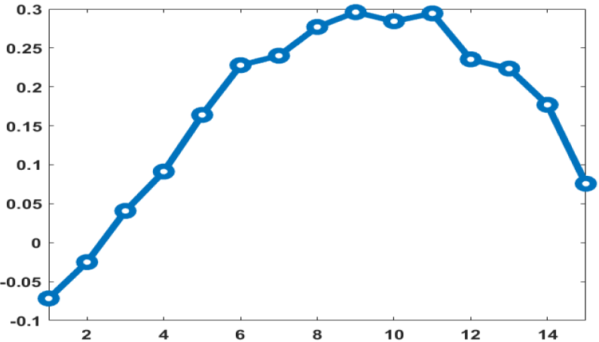
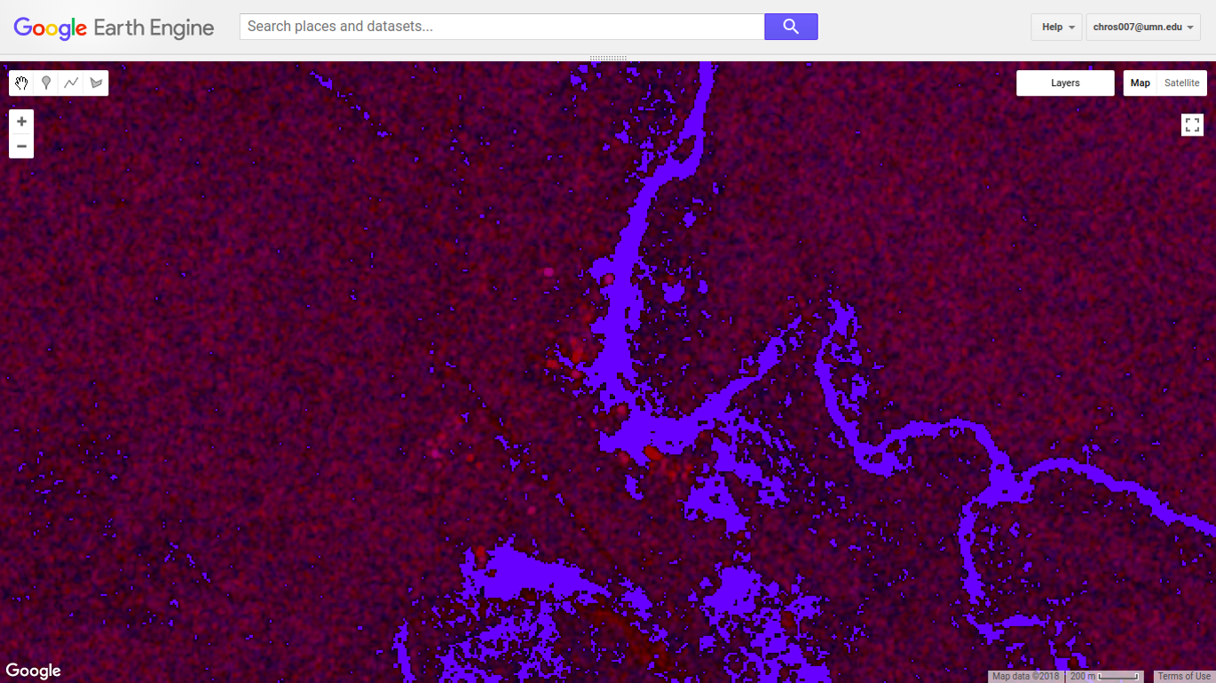
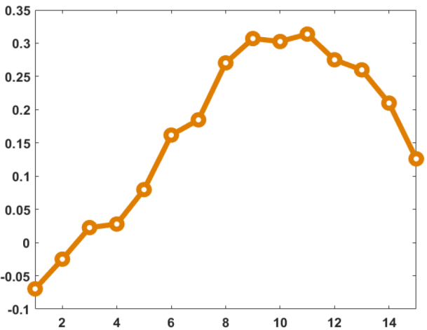
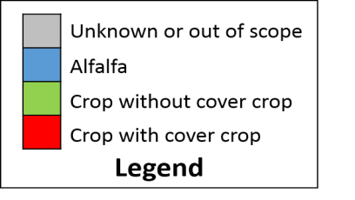
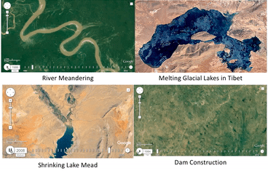
Creating Virtual Gauges When No Data Available
Work by Vipin Kumar and Ankush Khandelwal (UM)
Theory-guided data science incorporates biophysical laws into machine learning from remote sensing data
Corn
Soybean

Slide 11
MINT: From Models to Solutions
Work with Deborah Khider (USC), Suzanne Pierce and Lissa Pearson(UT)
Data formats
Physical variables
Constraints
Adjustable parameters

Slide 12
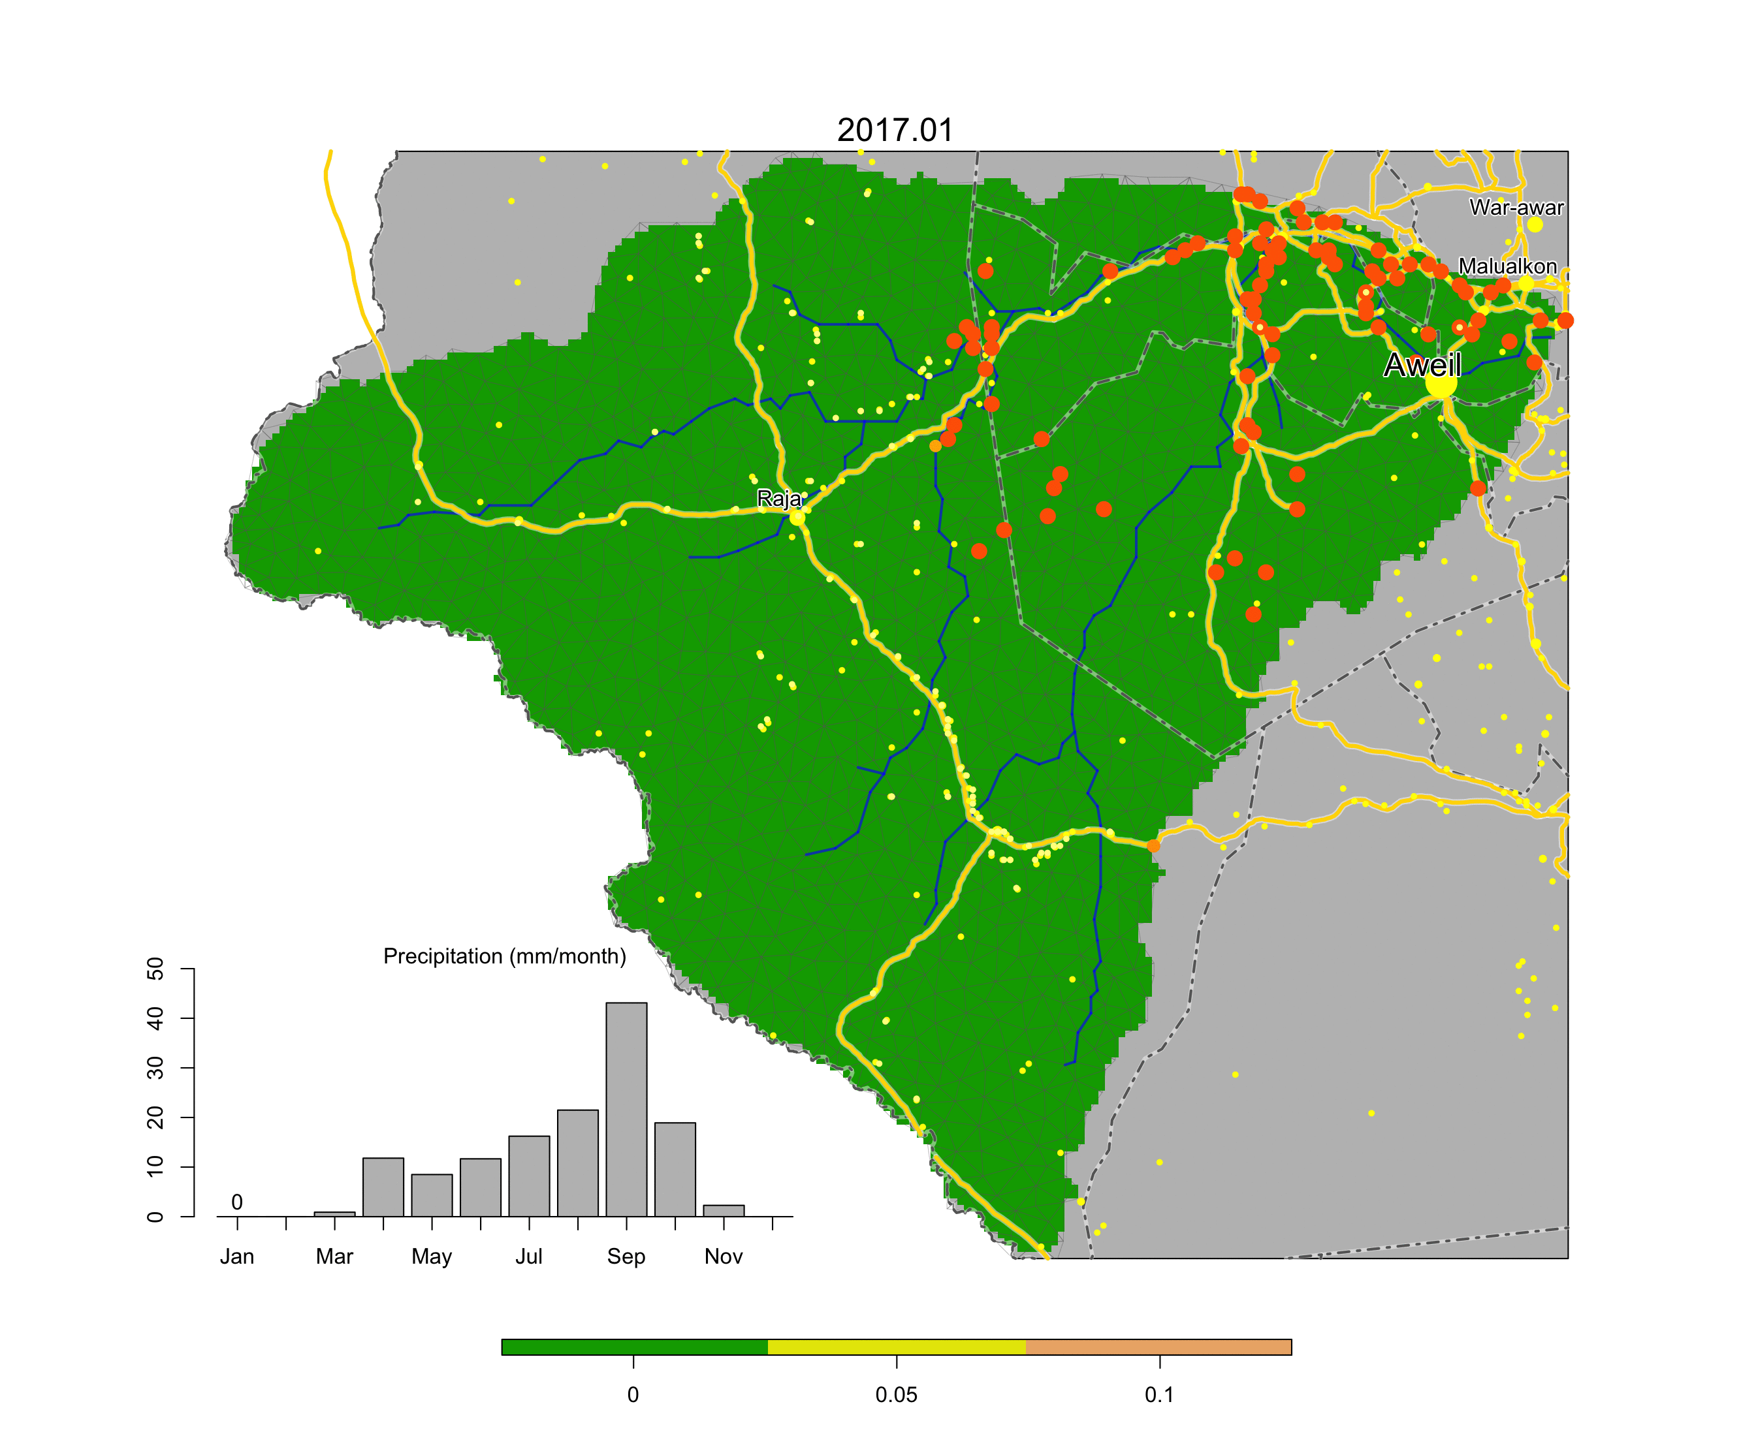
Flooding
Work by Chris Duffy and Lele Shu (PSU)

Slide 13
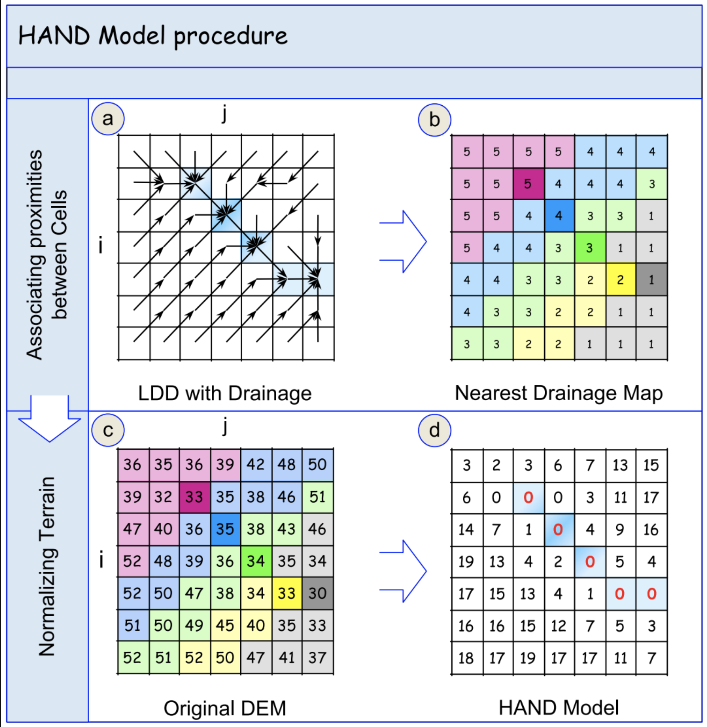
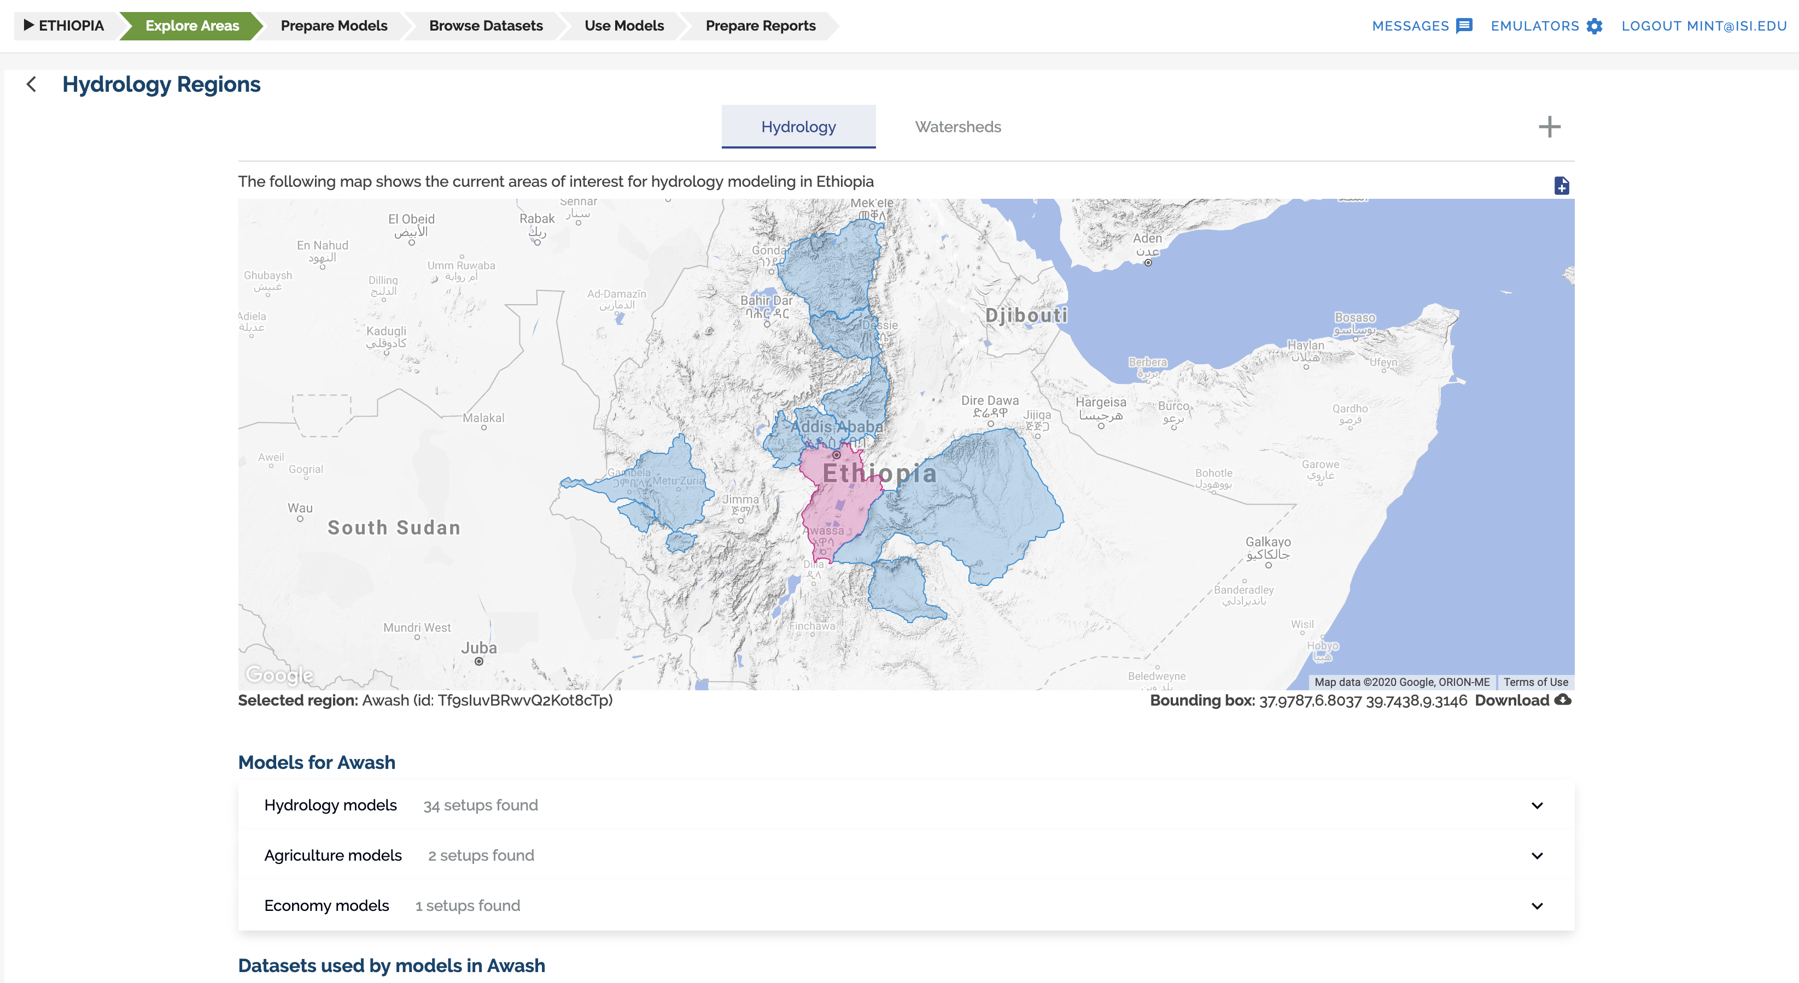

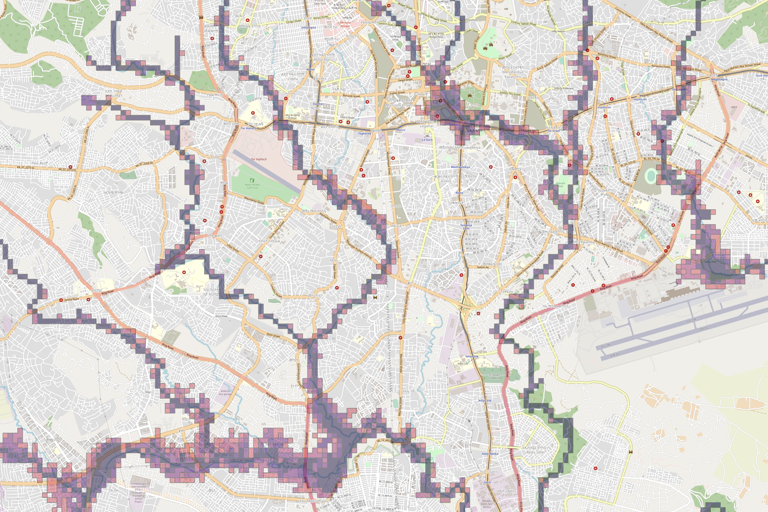
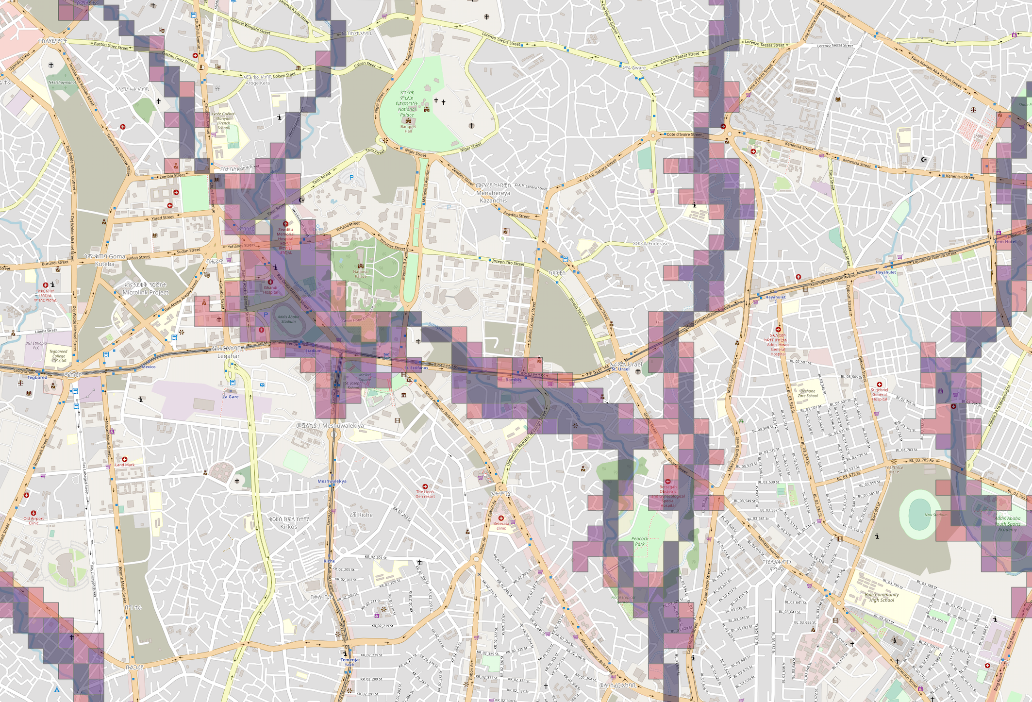
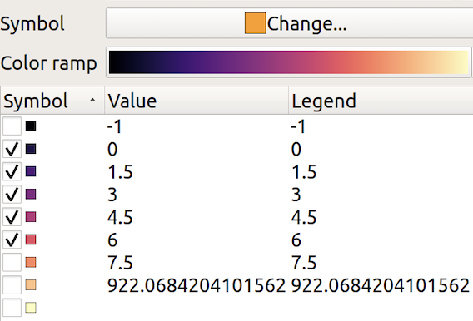
Portable Flood Risk Analyses
Work with Daniel Hardesty Lewis, David Arctur Paola Passalacgua (UT), David Tarboten (Utah State) and Misty Porter, Mary Hill (KU)
Data Scarce Region - Ethiopia | Awash Basin
Results provide:
1) first pass vulnerability
2) Pixels with colors on right of scale (brighter red) indicate higher change of inundation or flooding
Multiple Data Input
and Model Options
To refine the scale
Height Above Natural Drainage Model (HAND)

Slide 14
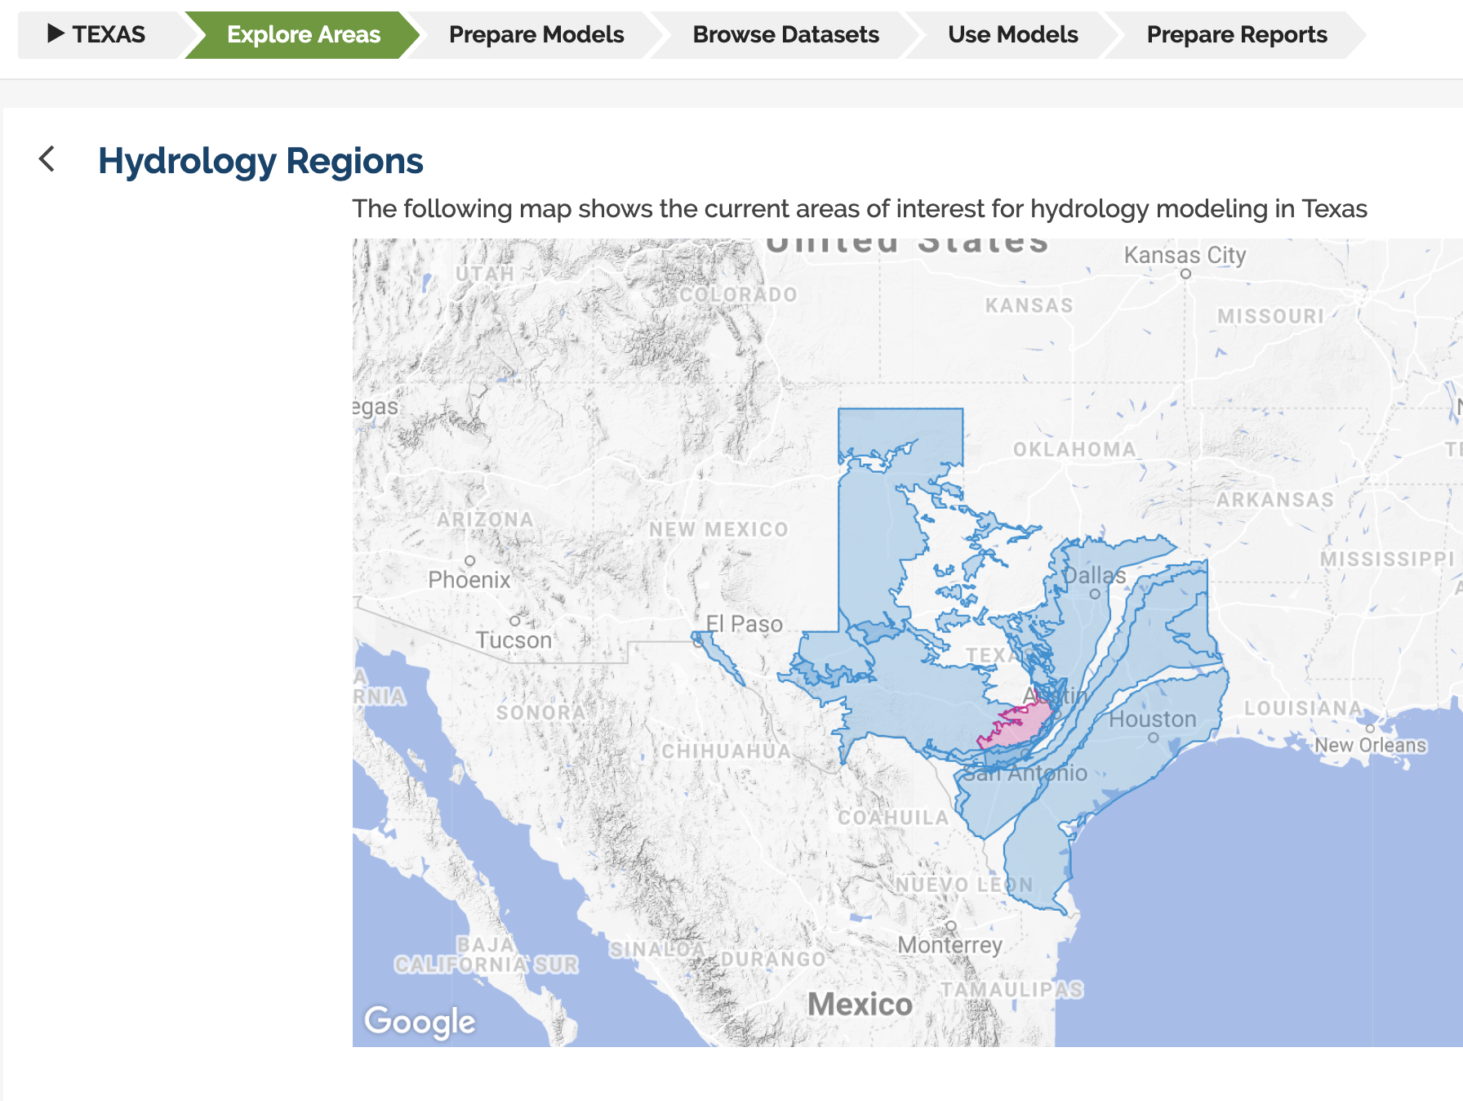
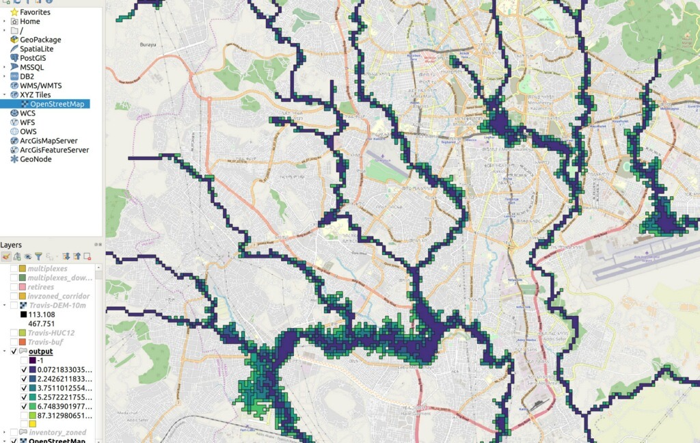
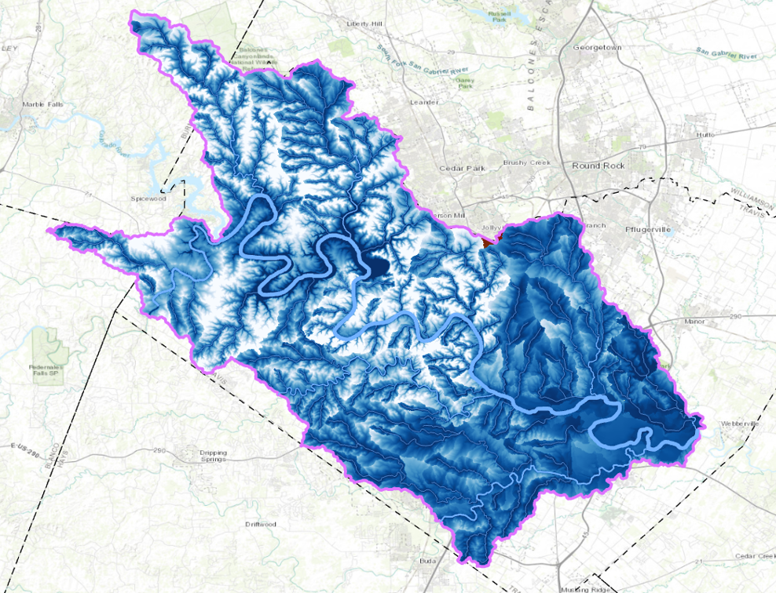
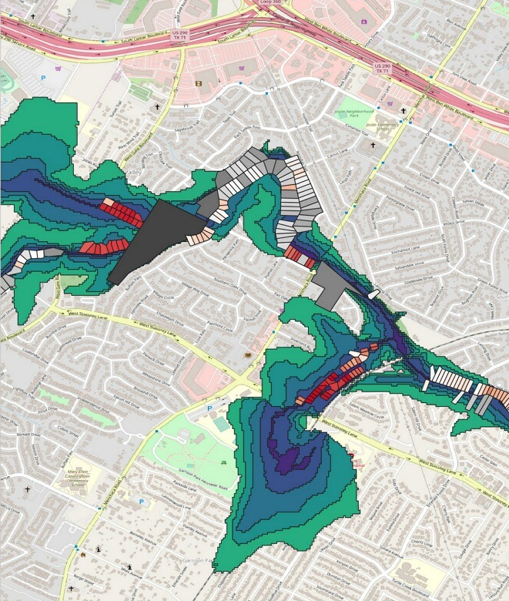
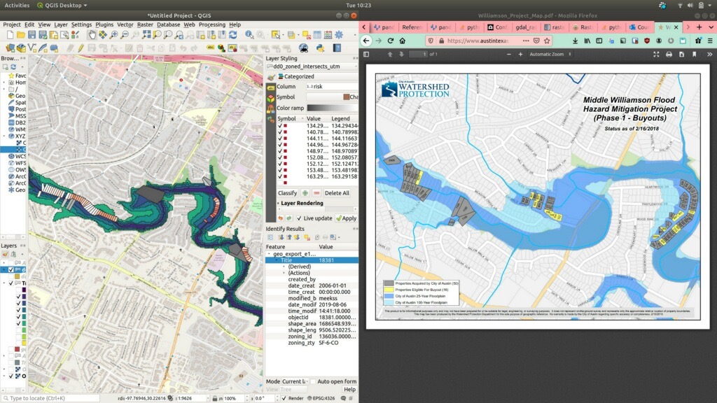
Combining Flood Models with Data
Work with Daniel Hardesty Lewis, David Arctur and Paola Passalacgua (UT)
Data Rich Region - United States | Central Texas
Combining
Terrain (10 m, 1 meter next)
Population
Urban Land Use
Travis County
Comparison Williamson County
Manually Constructed Buyout Map
MINT Generated Vulnerability Map
Automating assessment using portable flood model workflow with higher resolution base data

Slide 15
Combining Flood Models with Data
Work with Daniel Hardesty Lewis, David Arctur and Paola Passalacgua (UT)
Data Rich Region - United States | Central Texas
Combining
Terrain (10 m, 1 meter next)
Population
Urban Land Use
Travis County
Comparison Williamson County
Manually Constructed Buyout Map
MINT Generated Vulnerability Map
Automating assessment using portable flood model workflow with higher resolution base data

Slide 16
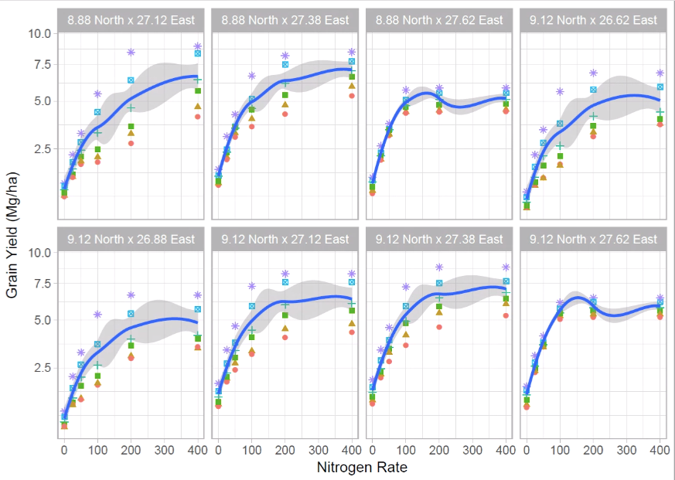
Crop Production
Work with Armen Kemanian (PSU), Kelly Cobourn (VT), Daniel Garijo, Ewa Deelman, Rafael Ferreira (USC)

Slide 17

Future Research Agenda
With Suzanne Pierce (UT)

